Slide 1
AP9559,AP9560,AP9562 Label Approval

Slide 2
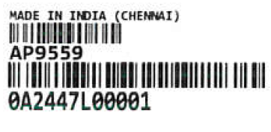
AP9559-ID LABEL
LABEL SIZE:35X12MM
Product Part number
Product Serial Number

Slide 3
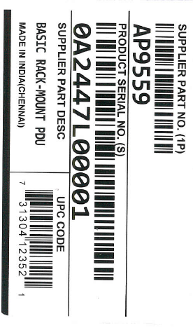
AP9559-Packing Label
LABEL SIZE:102X62MM
Product Part number(1P)
UPC CODE
Product Serial Number(S)
Product Description
“0”-Factory code
“A”-Factory code identifier
“24”-Year
“47”-production Week
“L”-Contract manufacture index
“0001”-Unit number

Slide 4
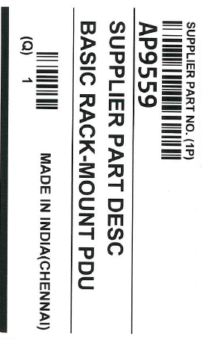
AP9559-Origin Label
LABEL SIZE:102X62MM
Product Part number
Product Qty

Slide 5
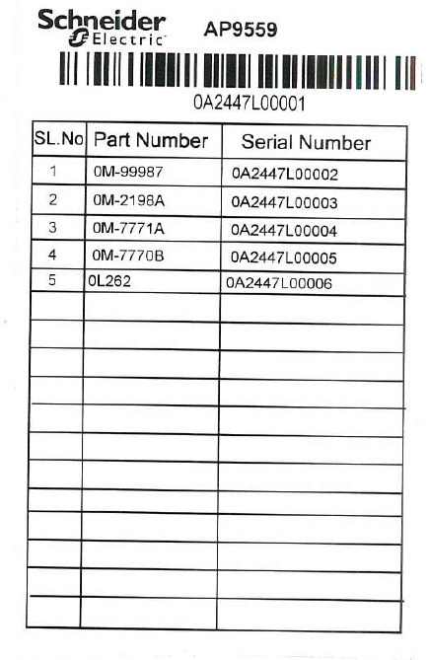
AP9559-LIT KIT LABEL
LABEL SIZE:102X62MM
Product Serial Number
List of Kit used in project

Slide 6
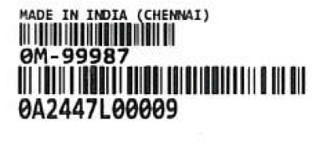
0M-99987-Accessory ID LABEL
LABEL SIZE:35X12MM
KIT assembly part number
Product Serial Number

Slide 7
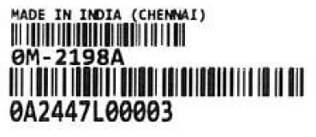
0M-2198A-Accessory ID LABEL
LABEL SIZE:35X12MM
KIT assembly part number
Product Serial Number

Slide 8
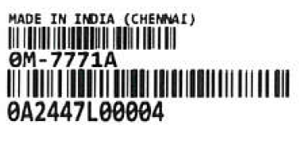
0M-7771A- Accessory ID LABEL
LABEL SIZE:35X12MM
KIT assembly part number
Product Serial Number

Slide 9
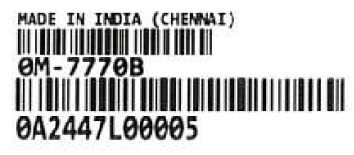
OM-7770B-Accessory ID LABEL
LABEL SIZE:35X12MM
KIT assembly part number
Product Serial Number

Slide 10
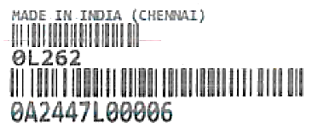
OL262- Accessory ID LABEL
LABEL SIZE:35X12MM
KIT assembly part number
Product Serial Number

Slide 11
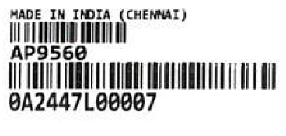
AP9560- ID LABEL
LABEL SIZE:35X12MM
Product Part number
Product Serial Number

Slide 12
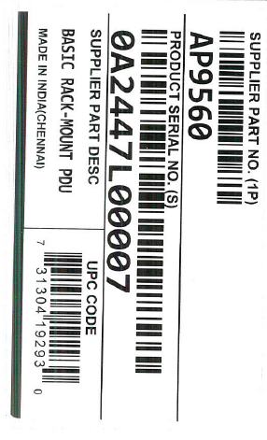
AP9560-Packing Label
LABEL SIZE:102X62MM
ProductPart number(1P)
UPC CODE
Product Serial Number(S)
Product Description
“0”-Factory code
“A”-Factory code identifier
“24”-Year
“47”-production Week
“L”-Contract manufacture index
“0001”-Unit number

Slide 13
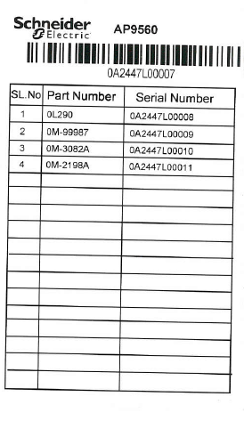
AP9560-LIT KIT LABEL
LABEL SIZE:102X62MM
Product Serial Number
List of Kit used in product

Slide 14
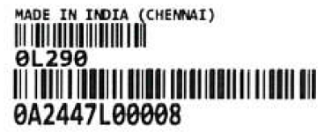
OL290- Accessory ID LABEL
LABEL SIZE:35X12MM
KIT assembly part number
Product Serial Number

Slide 15
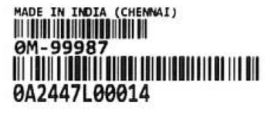
0M-99987-Accessory ID LABEL
LABEL SIZE:35X12MM
KIT assembly part number
Product Serial Number

Slide 16
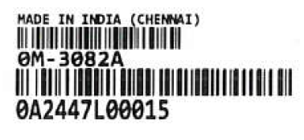
OM-3082A- Accessory ID LABEL
LABEL SIZE:35X12MM
KIT assembly part number
Product Serial Number

Slide 17
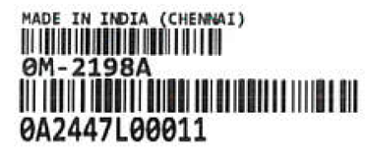
OM-2198A- Accessory ID LABEL
LABEL SIZE:35X12MM
KIT assembly part number
Product Serial Number

Slide 18
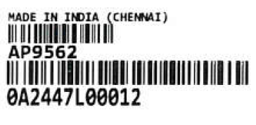
AP9562-ID LABEL
LABEL SIZE:35X12MM
Product Part number
Product Serial Number

Slide 19
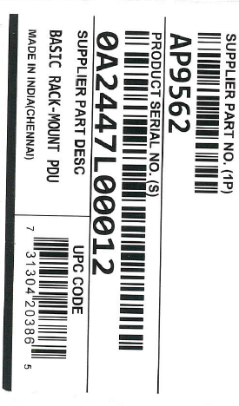
AP9562-Packing Label
LABEL SIZE:102X62MM
ProductPart number(1P)
UPC CODE
Product Serial Number(S)
Product Description
“0”-Factory code
“A”-Factory code identifier
“24”-Year
“47”-production Week
“L”-Contract manufacture index
“0001”-Unit number

Slide 20
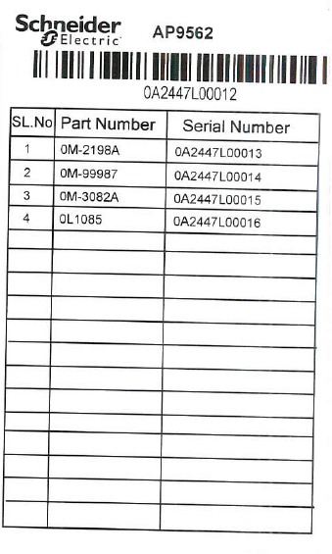
AP9562-LIT KIT LABEL
LABEL SIZE:102X62MM
Product Serial Number
List of Kit used in product

Slide 21
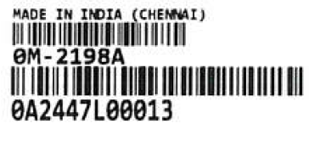
0M-2198A- Accessory ID LABEL
LABEL SIZE:35X12MM
KIT assembly part number
Product Serial Number

Slide 22
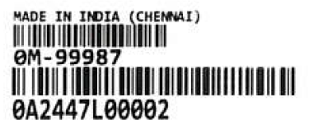
0M-99987- Accessory ID LABEL
LABEL SIZE:35X12MM
KIT assembly part number
Product Serial Number

Slide 23
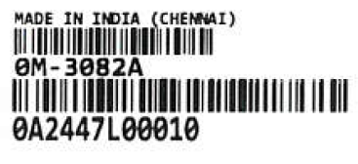
0M-3082A-Accessory ID LABEL
LABEL SIZE:35X12MM
KIT assembly part number
Product Serial Number

Slide 24
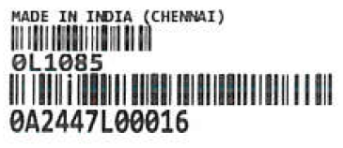
OL1085- Accessory ID LABEL
LABEL SIZE:35X12MM
KIT assembly part number
Product Serial Number

Slide 25
The End and Thanks

